Slide 1
Beginning Birding
Spring & Summer Birds
Thomas Bancroft
Spring 2019
Notes:
Expert birders don’t focus on field marks and plumage detail
What group of birds does this one belong to?
What is the overall size, sparrow, robin, crow, goose
What do the body parts look like
Head shape and size
bill shape and size
Wing length and shape
Tale length and sharp
Color Pattern
Not the details of color but the big picture of color
Where is the color found, how much
What kind of patterns does it form
Need to know the parts of the bird to describe this
Behaviors
Foraging
Flight
how it moves
Habitat
wetlands
woods
grasslands
urban – suburban area

Slide 2
You Will Need either or both
The Merlin App
  http://merlin.allaboutbirds.org
A bird book to Western Birds or Birds of North America

Slide 3
Key Birding Skills
Size & Shape
Color Patterns
Behavior
Habitat
Songs & Calls
Notes:
Expert birders don’t focus on field marks and plumage detail
What group of birds does this one belong to?
What is the overall size, sparrow, robin, crow, goose
What do the body parts look like
Head shape and size
bill shape and size
Wing length and shape
Tale length and sharp
Color Pattern
Not the details of color but the big picture of color
Where is the color found, how much
What kind of patterns does it form
Need to know the parts of the bird to describe this
Behaviors
Foraging
Flight
how it moves
Habitat
wetlands
woods
grasslands
urban – suburban area
It is about Observation and Not Memorization.
GOOD EXAMPLE: Think about your family and friends. You can often recognize them when you see them across the street, on the other side of a crowd. It is not because you memorized their characteristics. Your brain is really good at picking up lots of subconscious things that you get through observation.

Slide 4
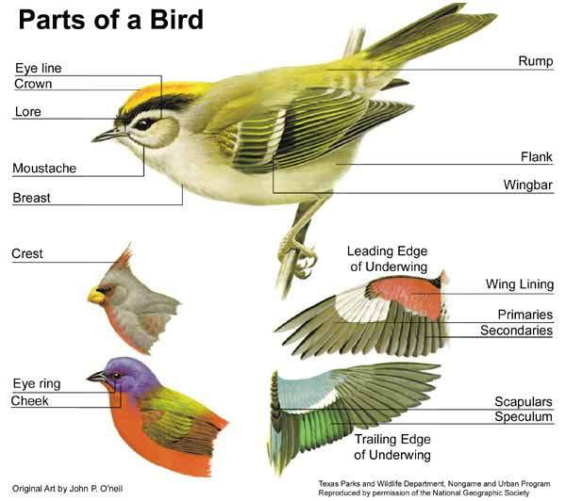
Parts of a Bird
Notes:
Patterns are often important, and where one the body the large color patters might be.
Head
Wing – does it have wing bards
Crest on head
Eye ring
Wings
Primaries
Secondaries
Upper wing
Underwing

Slide 5
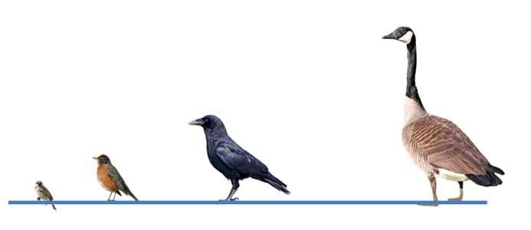
Size – The Bird Yardstick
Don’t focus on Plumage Detail
Practice on Common Birds
Put bird into a group of birds, family
Size comparison is key
Notes:
Size comparison is key
Put it on this size scale, rather than estimate it size in inches or metrics
Sparrow, Robin, Crow, Canada Goose

Slide 6
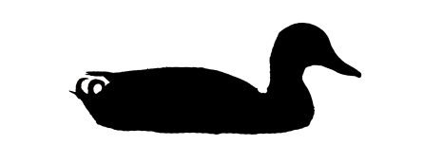
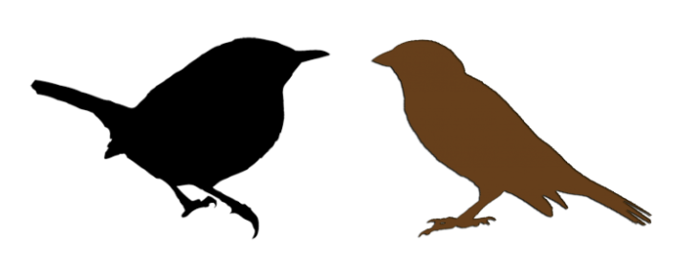

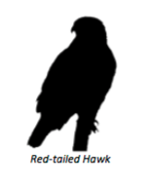
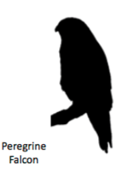
Shape
Overall impressions
Key into
  Head
  Bill length and shape
  Wing length
  Tail length
  Wing length vs Tail length
Notes:
Overall impression of shape,
You probably recognize a lot more shapes that you realize and we will work on giving you more around shape.
Shape helps put a bird into a group of birds. This helps narrow the list down of what something might be.
NOTE: Birds can fluff up their feathers, adjust their body size by extending their neck or looking in a direction. The two robins on the bottom.

Slide 7
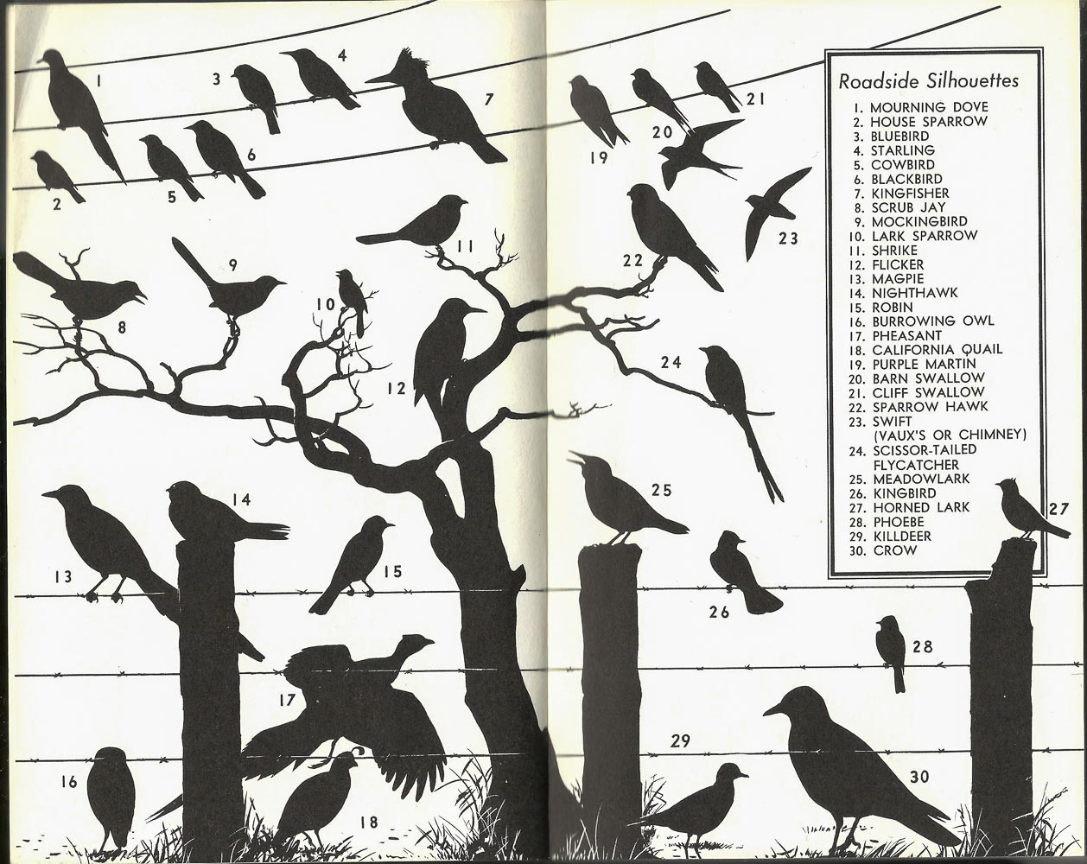

Slide 8
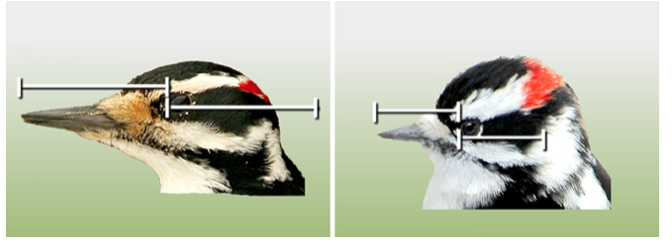
Make Comparisons within the Bird
Compare it to itself
Downy & Hairy Woodpecker
Length of Wing to Length of Tail
Notes:
When we look at hawks and falcons later tonight. The length of the wing relative to the length of the tail will be a key factor

Slide 9
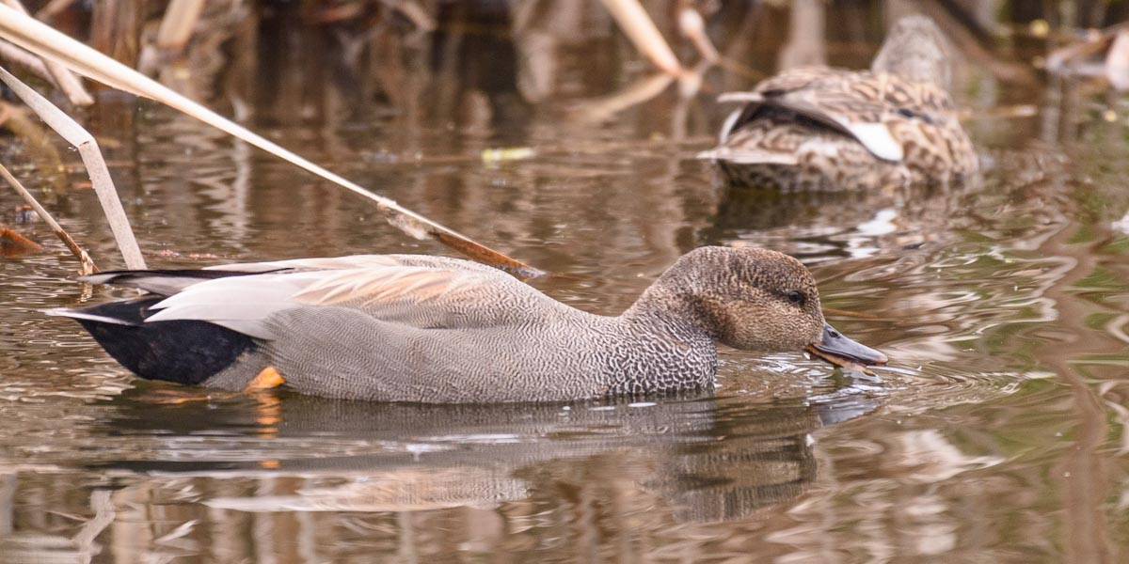
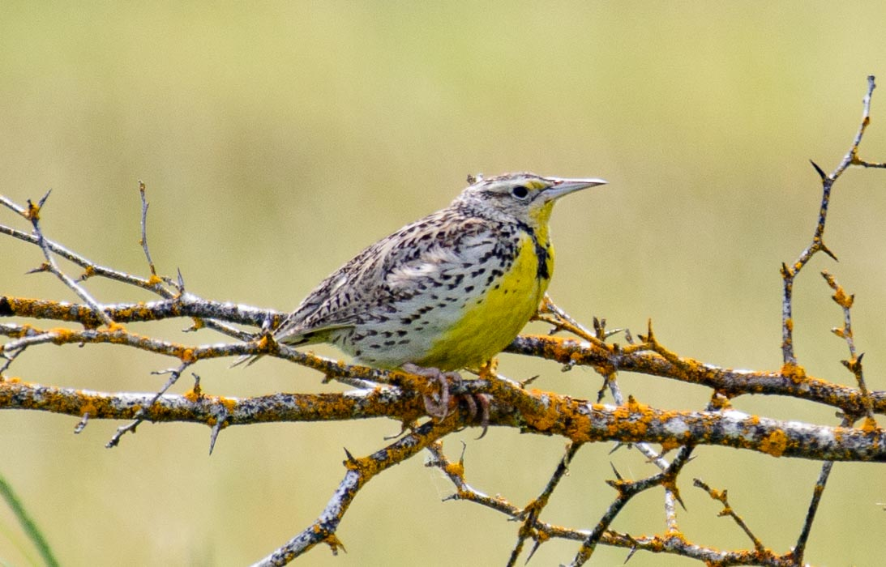
Color Pattern
Color attracts us,
But focus more on the pattern
  Where is the color
Notes:
Ignore the fine detail. Focus on overall color pattern
Gadwall
Black back size, gray body, with slightly darker head, this is enough to identify this as a gadwall
Meadowlark
Yellow throat and check with large black V
back that is mottled brown and white
look at the bill too, not the conical bill of a sparrow, not the big bill of a grosbeak,
This is a western meadowlark,

Slide 10
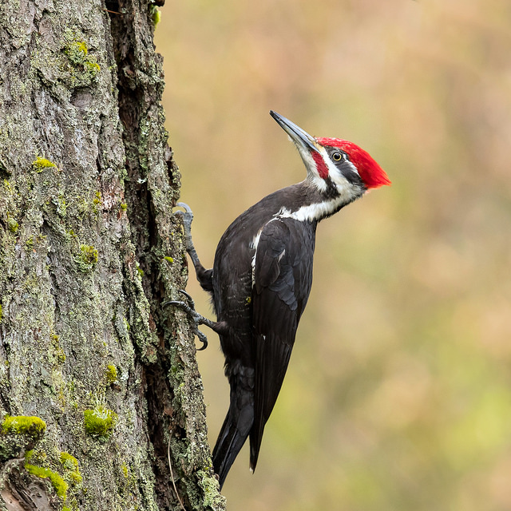
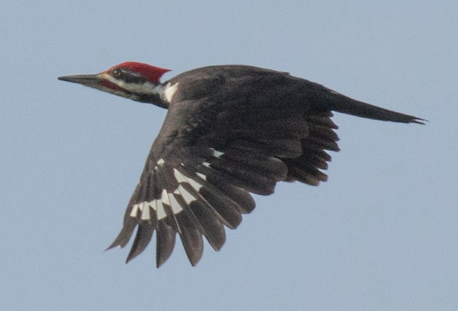
Field Guides
Perfect Plumage
Focus on the Big Picture, and overall color pattern
Overall Impression of how color pattern is arranged
  Body Parts
  Patterns
  Major features
Notes:
Don’t look for the fine detail of plumage, the little things, might not see them in the heat of the moment
Field guides are essential. Peterson’s field guides were revolutionary in that they pointed to the key things to look at
Field guides show birds in perfect plumage and in ideal light. You rarely have those condition.
Don’t look at the subtle detail but at the overall color pattern.
Overall pattern of color arranged on the body, can be simple or detailed.
Describe the color of pattern, black body with red crest and white on wings
If additional features, can look at more detail.
If you just had a very brief look at thie Pileated woodpecker, you might describe it has having a black body, red on head and some white, black and white pattern on its head and neck
LOOK at body parts and patterns and features that really stand out
head and
wings
Variation between individual

Slide 11
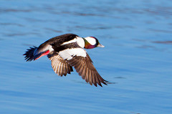
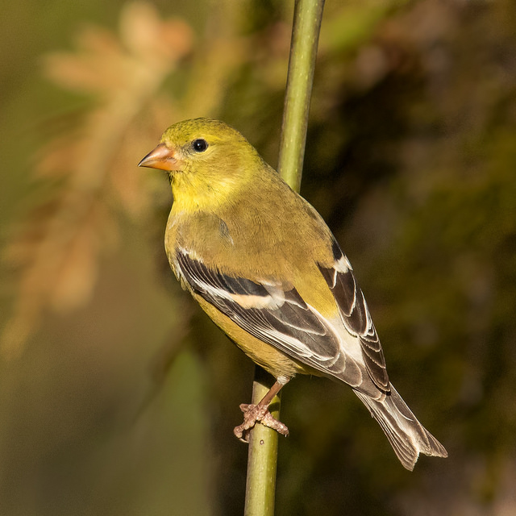
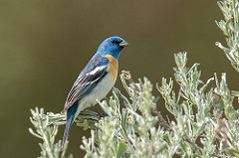
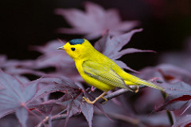
Most Important Things
Head
Wings
Photos by Mick Thompson

Slide 12
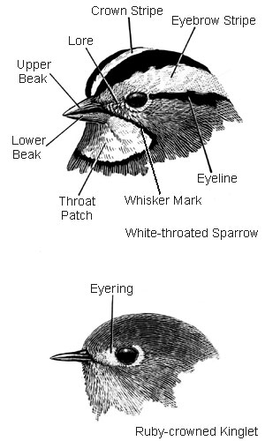
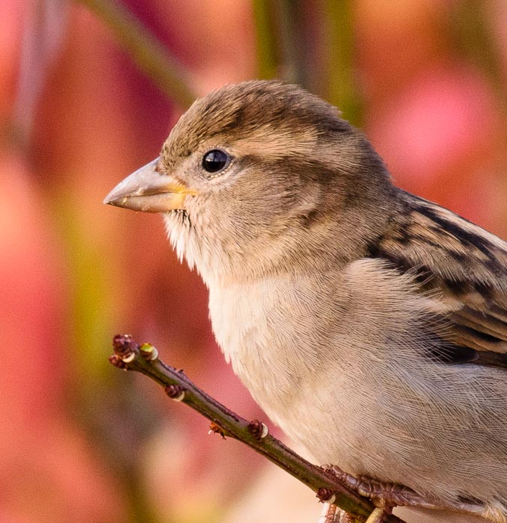
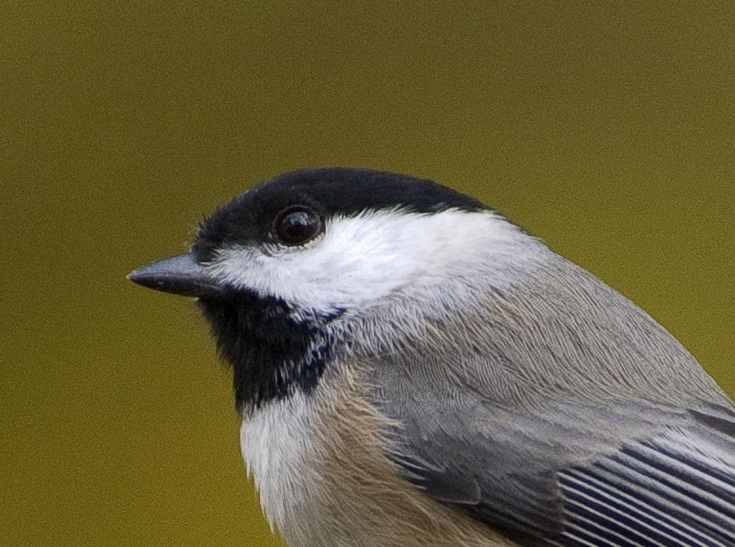
Head

Slide 13
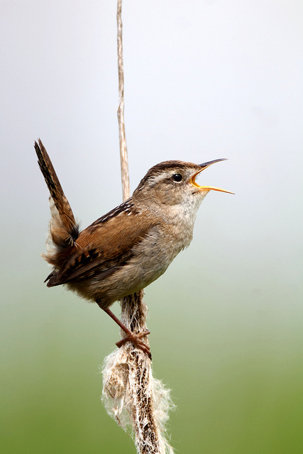
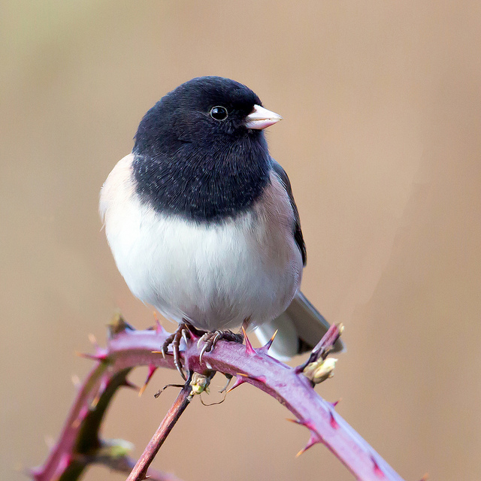
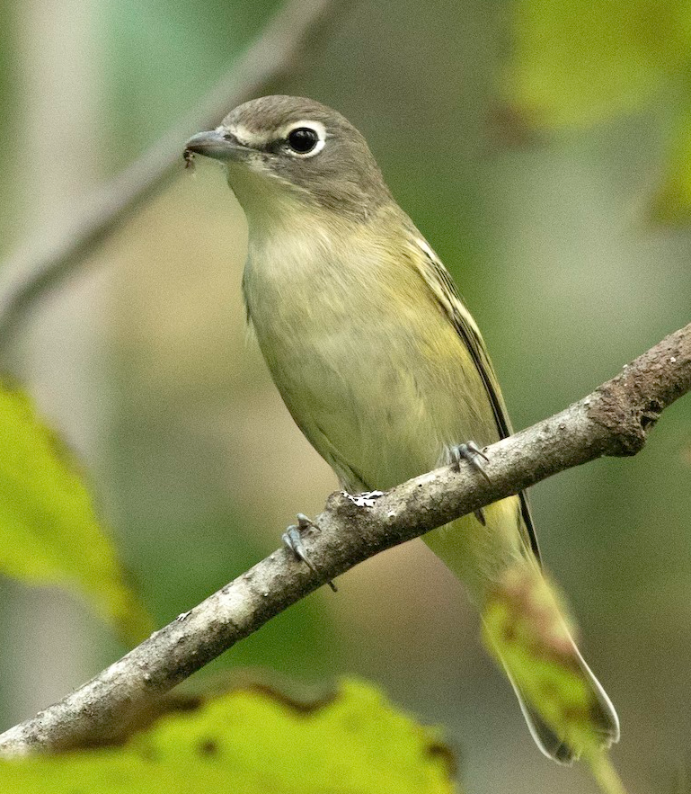
Head Features
Look at different heads
  Show crowns
  Eye rings
  Spectacles
Notes:
Head – pattern of feathers, where found
Bill shape and size
What is happening around the eye
eye ring
spectacles

Slide 14
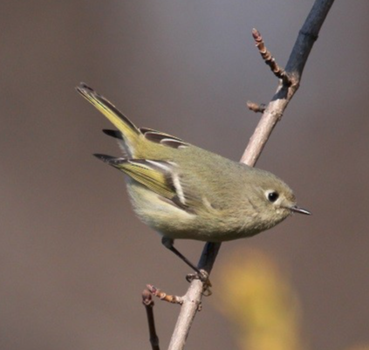
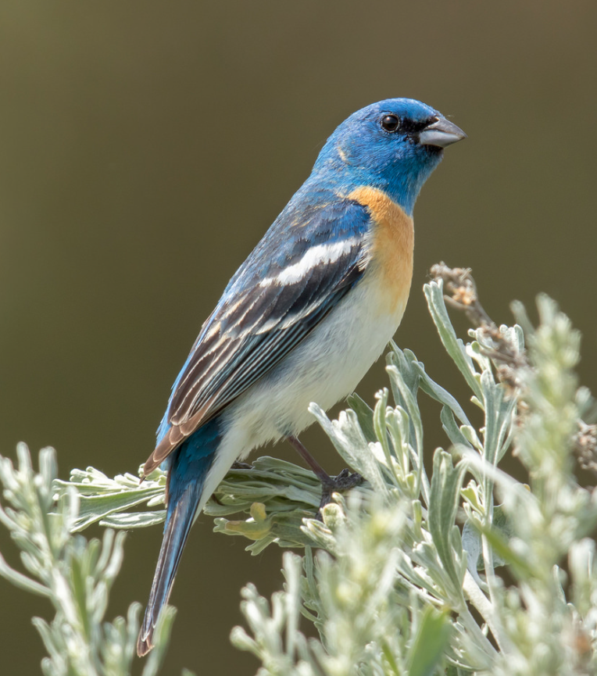
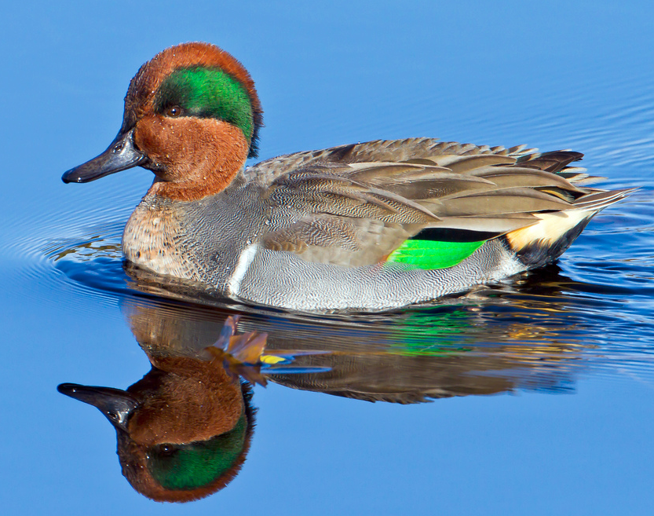
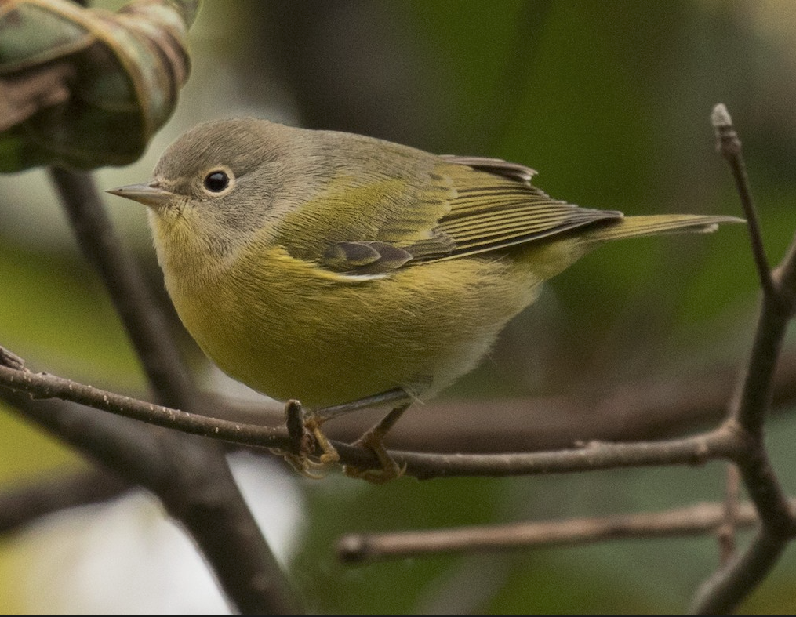
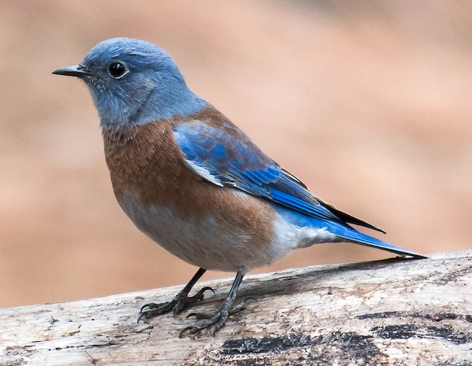
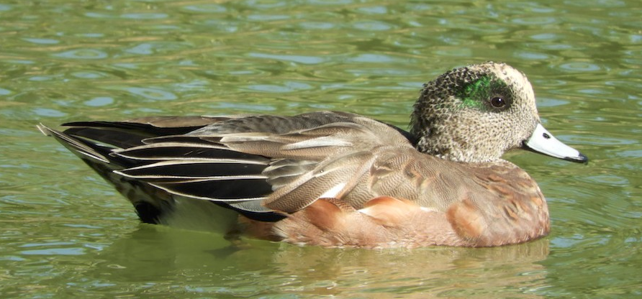
Wing Patterns
Notes:
At this stage, you are doing an inventory, not trying to memorize these details on species. You’re trying to see that key characteristics so when you look the bird up you have that knowledge. Learning to recognize these without looking them up will come with time. Right now, it is the big picture and making that inventory so you have you set of information on a species.
Ruby-crowned Kinglet
wing bars
eye rign
small bill
olive gray both and underside, lighter belly
Orange-crowned Warbler
NO wing bars
more of a yellowish ting to underside, although there is lots of variation in the amount that you see
Eye ring
Lazuli Bunting & Western Bluebird
Wing bars on the Lazuli Bunting (Western and Mountain Bluebirds don’t have wing bars)
Bill shape,
How they hold their bodies, sometimes that is hard to see, but is a good characteristic, they sit differently.
Two Ducks
Both have green on their head, coming from the eye area and extending backwards
The wings and other patterns are different.

Slide 15
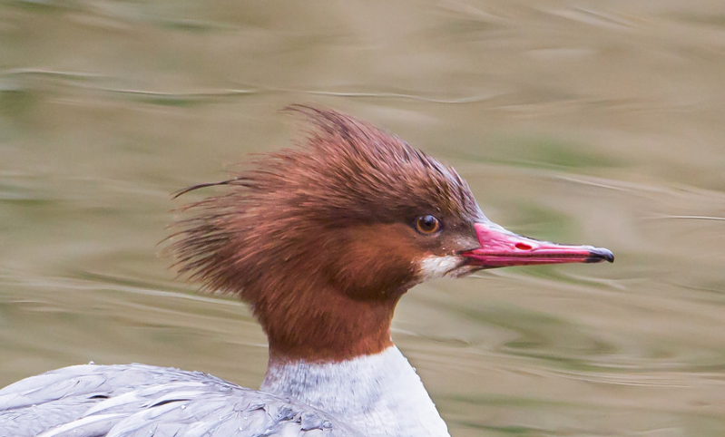
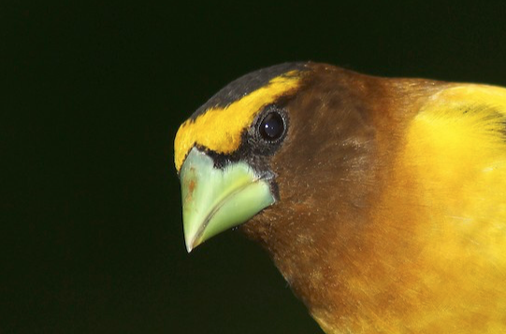
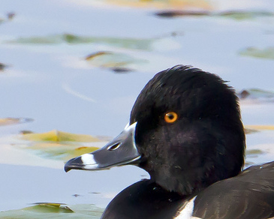
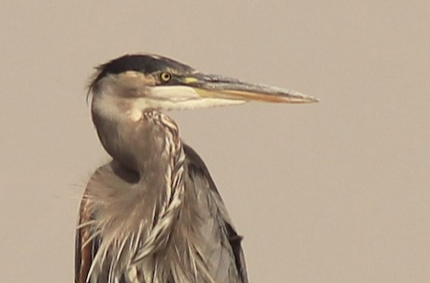
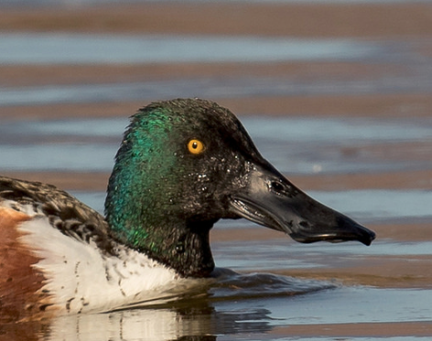
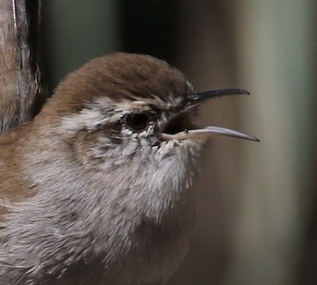
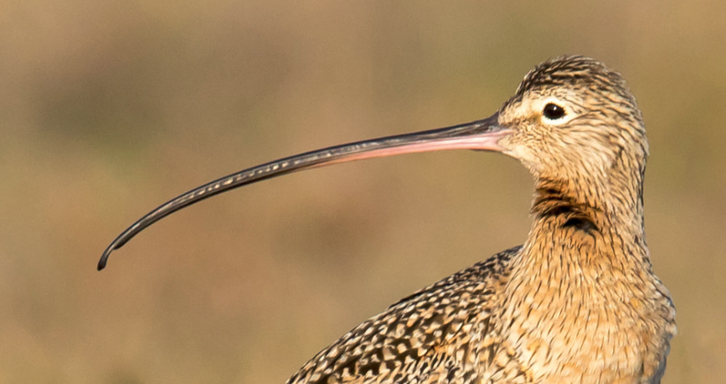
Bills
Notes:
Look at the diversity of bills.

Slide 16
Understanding Behavior
Behaviors are often consistent, with few exceptions
  Posture
  Foraging
  Flight Style

Slide 17
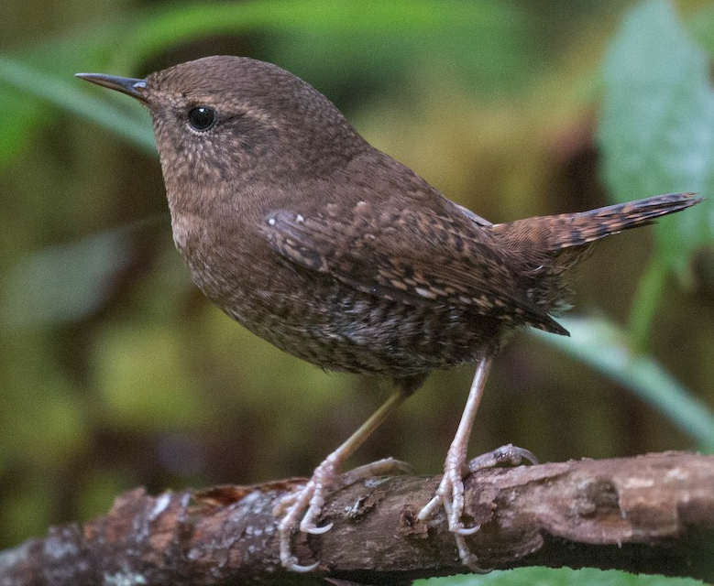
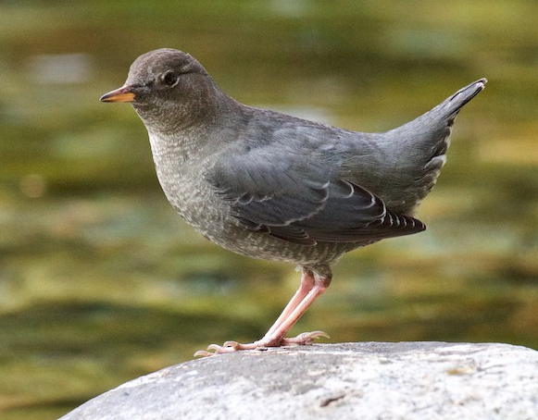
Posture
Where do you see them
How do they perch, sit, swim
Repeated movements of a body part
Notes:
Dipper
Pacific Wren

Slide 18
Foraging Behavior
Where do they forage?
How does it forage?
What do they eat?
Notes:
Swallows,
Hawks
Plovers vs dowitchers
Brown creepers, nuthatches, woodpeckers
Feeders
Sparrows on the ground, scratching
Chickadees flying in and out of a feeder
Finches just sitting on the feeder, eating away.
Woodpeckers
Bushtits

Slide 19
Flight Style
Wing Beats
Direction of Flight
Notes:
Eagles vs Turkey Vultures
Terns
Short-eared owls
Fast moving flocks
Swift vs Swallows – very different

Slide 20
Habitat
Important Key to ID birds
Very adapted for certain habitats
  Place to eat, reproduce, survive, rest
  Often species specific
Forests, (coniferous or deciduous) wetlands, open water, scrub habitat, grasslands, agriculture, suburban, urban areas

Slide 21

Songs & Calls
Pitch
Tempo
Repetition
Pauses
Tone Quality

Slide 22
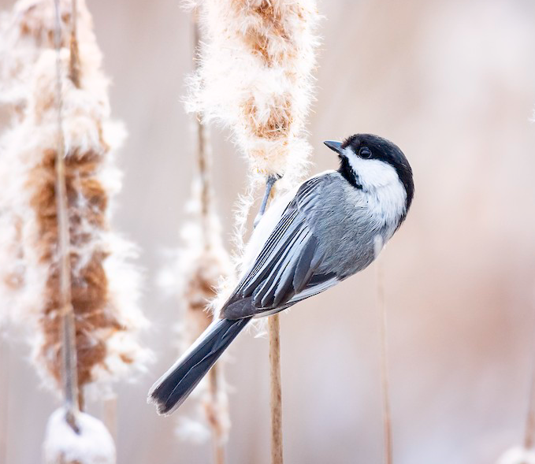
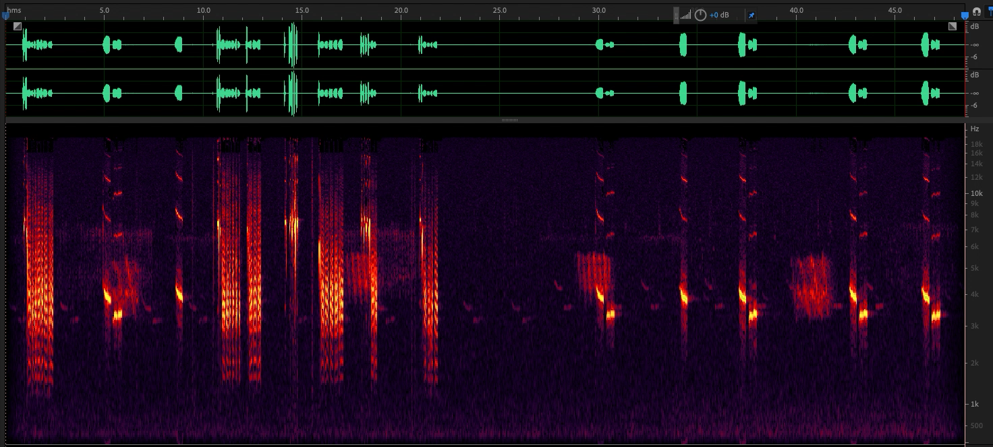
Repetition - Black-capped Chickadee
Notes:
Here are the call notes of the black-capped chickadee and the two note songs. Note the repeat notes
Repeat Notes of two part song.
Contains repetitions or duplicate notes or phrases

Slide 23
Review
Size and Shape
Color Pattern
Behavior
Habitat
Calls & Songs

Slide 24
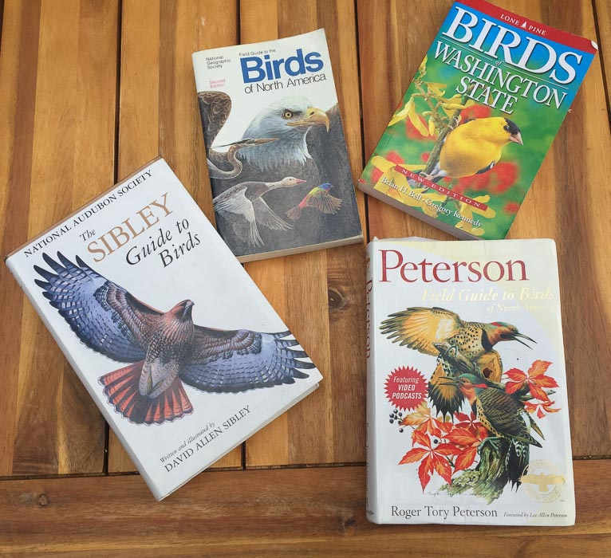
Field Guides – Taxonomic Order
Hard Copies
App Versions

Slide 25
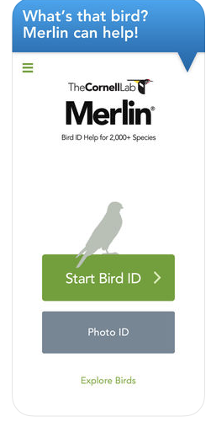
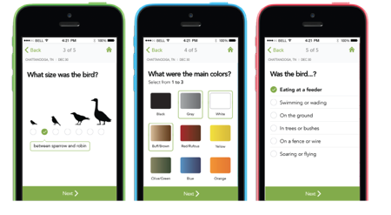
Merlin
Set location Magnuson Park
Set Date Day in May
What size was the bird?
Select 1 to 3 main colors?
What was the bird doing?
Will have a list of birds
  Either do
    detail or list mode

Slide 26
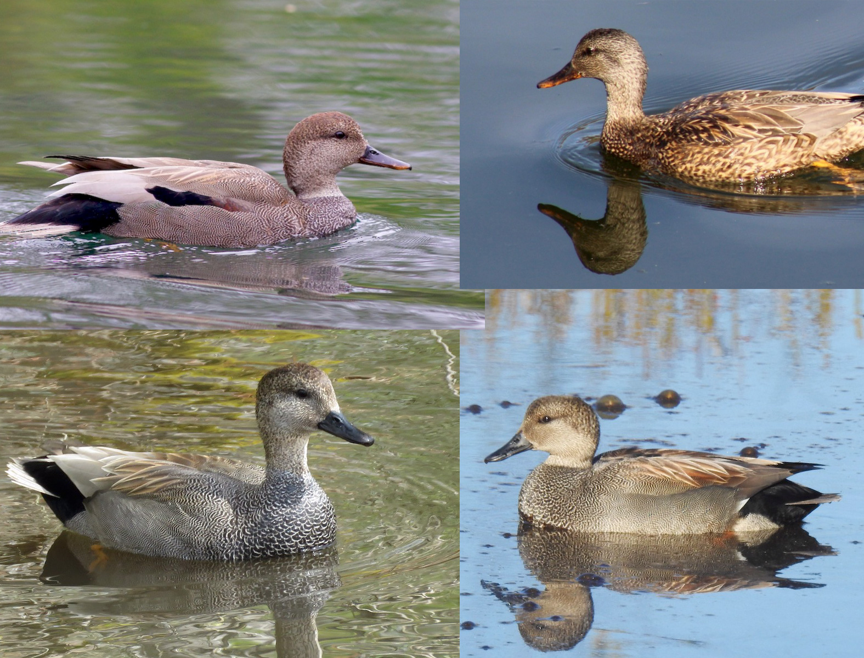


Slide 27
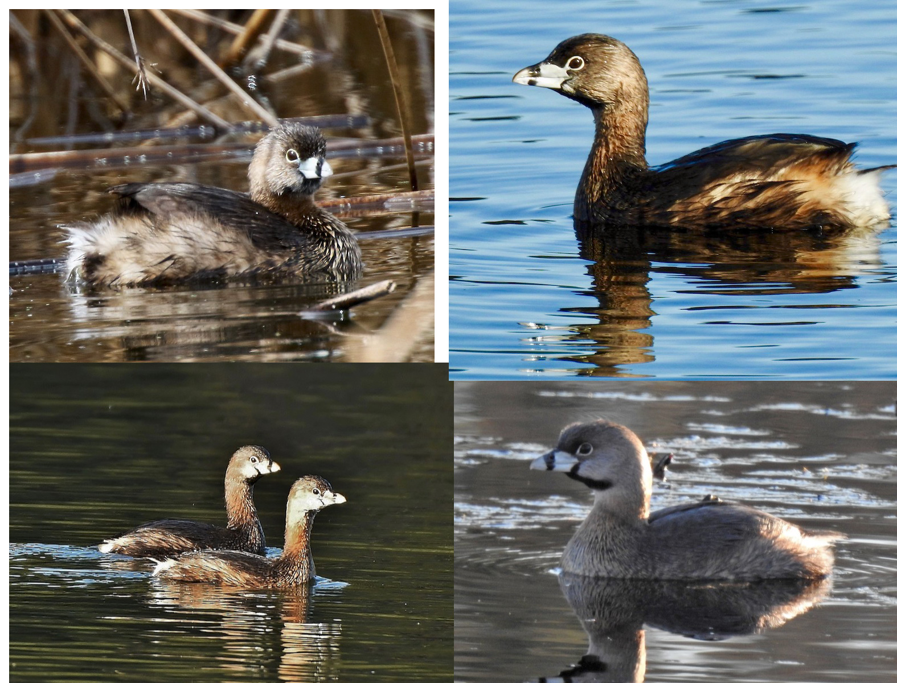

Slide 28
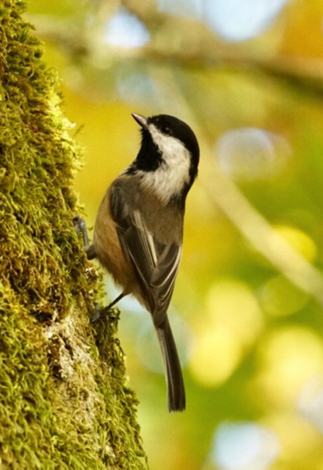
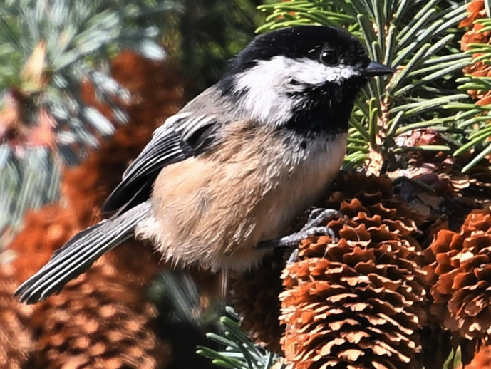
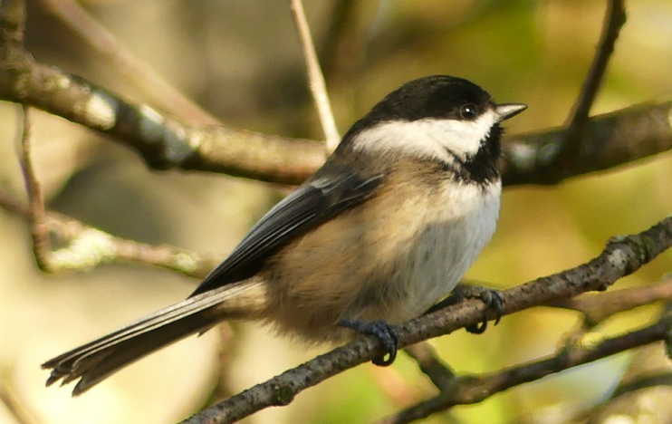
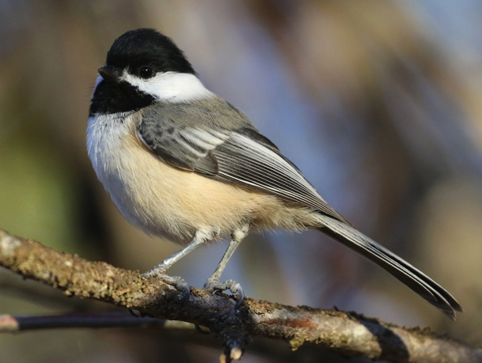

Slide 29
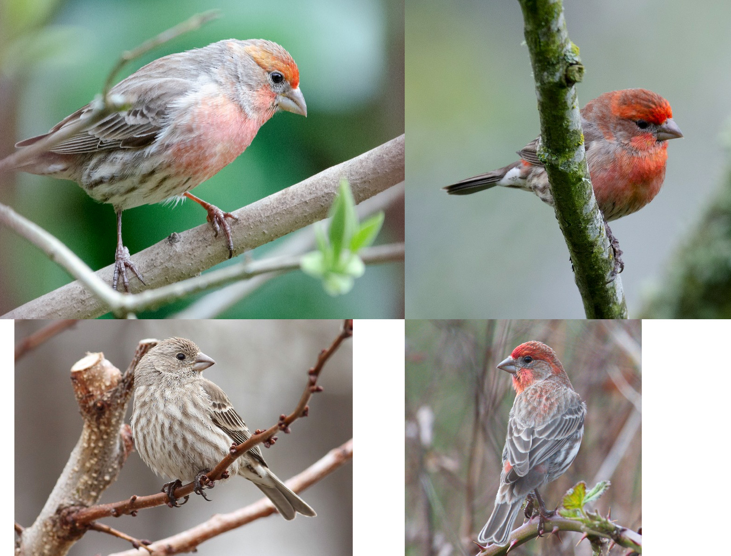
House Finch
Notes:
All the same species. Three pictures of males and one of female.

Slide 30
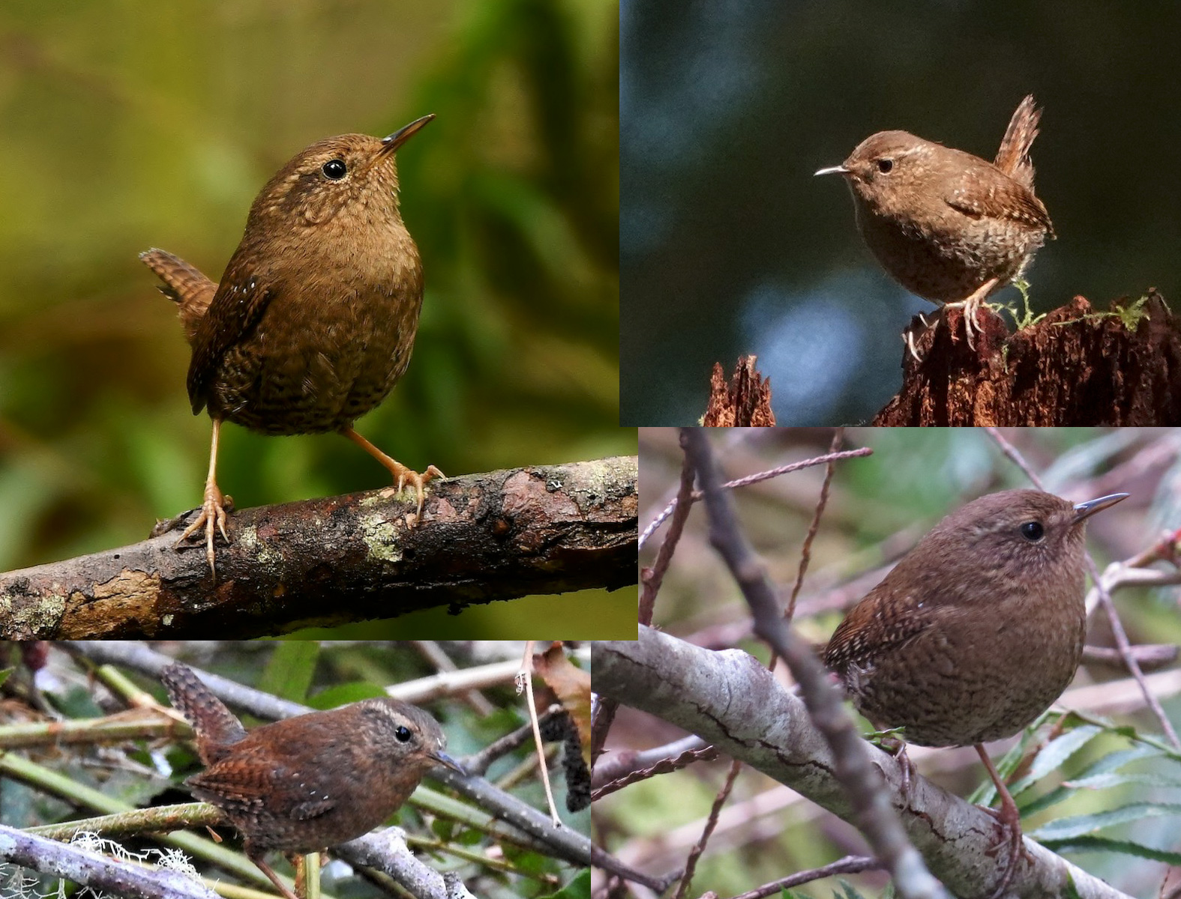

Slide 31
Using Field Guide
In Merlin – go to Home & then Exploring Birds
Or pick up a field guide

Slide 32





A
Two species
B
Marymoor Park

Slide 33




B
A
Four Species
Seattle
April - June
All Woodpeckers
But
Two don’t have
Woodpecker in their name
C
D

Slide 34
Opportunities to Bird
Seattle Audubon Neighborhood Bird Walks: http://www.seattleaudubon.org/sas/GetInvolved/GoBirding/NeighborhoodBirdWalks.aspx
Eastside Audubon does First Timer trip and walks. https://www.eastsideaudubon.org/calendar?view=calendar&month=05-2019
Marymoor Bird Walk – every Thursday https://www.marymoor.org/BirdingSchedule.htm
Nisqually National Wildlife Refuge – every Wednesday https://blackhills-audubon.org/event/bird-walk/

Slide 35
Resources for Bird Identification
All About Birds – Cornell Laboratory of Ornithology
  https://www.allaboutbirds.org
Merlin App
  http://merlin.allaboutbirds.org
BirdWeb
  http://www.birdweb.org/birdweb/index.aspx
Birding Locations- WA Birder’s Guide
  http://wabirdguide.org

Slide 36
Ten Tips for Watching Birds
Use all the information you can get
Try to see more than one characteristic
See the whole bird
If you know the common birds, the unusual ones will stand out
Expect variation in every species
Learn how birds and feathers move, so you know how a single bird can change

Slide 37
Ten Tips (Part II)
Size is only relative; compare a bird to something else, even itself
Watch birds with other people and learn from those with more experience
The magic of master birders is familiarity; the more time you spend watching, the better you
Everyone makes mistakes in bird identification, learn from yours

Slide 38

Questions?
Discussion!

Slide 39

Warblers
Study the body shape of these birds
Pointed bill
Longish thin tail
Wing shape

Slide 40

Body shape, bill shape, chunky nature, how they move

Slide 41


Slide 42



A
B
C
A – in suburban neighborhoods
B – in wetlands
C – in mature forests
Notes:
Habitat helps to separate them.

Slide 43

European Starling

Slide 44




Red-winged Blackbird

Slide 45

Common Bushtit

